Slide 1
Express.js
Examples

Slide 2
Example 1: basic_express.js:-Express is a node js web application framework that provides broad features for building web and mobile applications.
var express = require('express');
var app = express();
app.get('/', function (req, res) {
res.send('Welcome to JavaTpoint!');
});
var server = app.listen(8000, function () {
var host = server.address().address;
var port = server.address().port;
console.log('Example app listening at http://%s:%s', host, port);
});

Slide 3
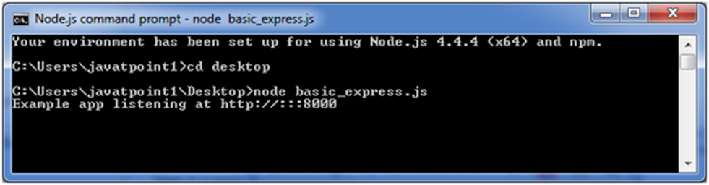
Command Prompt:

Slide 4
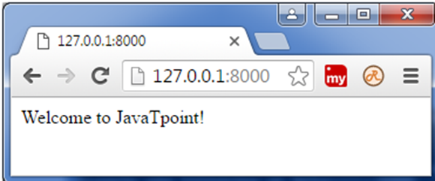
Output:

Slide 5
Example 2: Express.js GET Method:-Get method facilitates you to send only limited amount of data because data is sent in the header. It is not secure because data is visible in URL bar.
File: index.html
<html>
<body>
<form action="http://127.0.0.1:8081/process_get" method="GET">
First Name: <input type="text" name="first_name"> <br>
Last Name: <input type="text" name="last_name">
<input type="submit" value="Submit">
</form>
</body>
</html>

Slide 6
File: get_example1.js
var express = require('express');
var app = express();
app.use(express.static('public'));
app.get('/index.html', function (req, res) {
res.sendFile( __dirname + "/" + "index.html" );
})
app.get('/process_get', function (req, res) {
response = {
first_name:req.query.first_name,
last_name:req.query.last_name
};
console.log(response);
res.end(JSON.stringify(response));
})
var server = app.listen(8000, function () {
var host = server.address().address
var port = server.address().port
console.log("Example app listening at http://%s:%s", host, port)
})

Slide 7
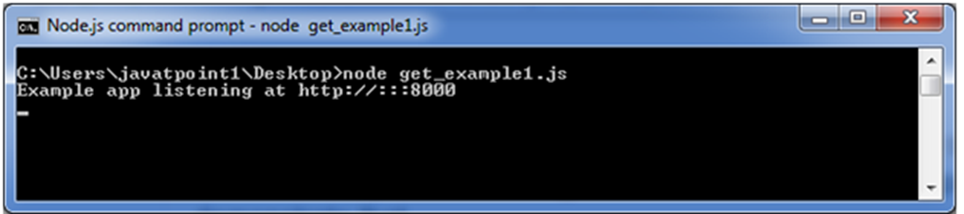
Command Prompt :-

Slide 8
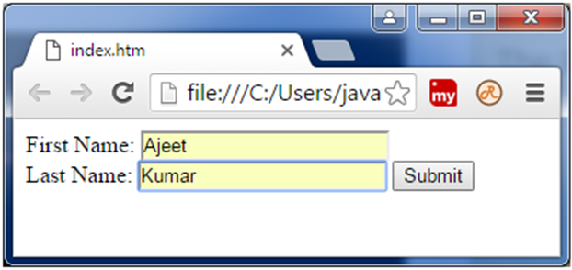
Open the page index.html and fill the entries:

Slide 9
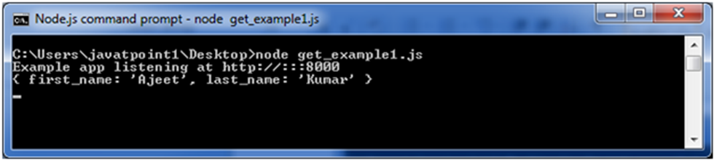
Now, you get the data in JSON format.

Slide 10
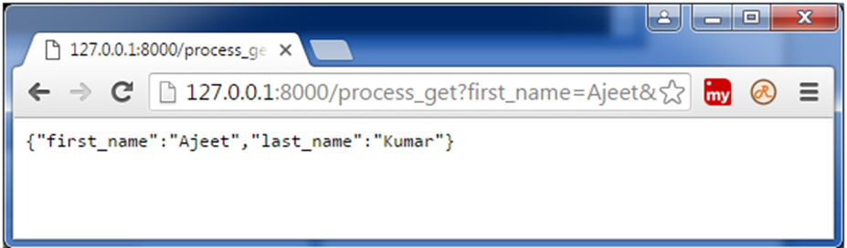
Output:-

Slide 11
Example 3:- Express.js GET Method :-Get method facilitates you to send only limited amount of data because data is sent in the header. It is not secure because data is visible in URL bar.
File: index.html
<html>
<body>
<form action="http://127.0.0.1:8000/get_example2" method="GET">
First Name: <input type="text" name="first_name"/> <br/>
Last Name: <input type="text" name="last_name"/><br/>
<input type="submit" value="Submit"/>
</form>
</body>
</html>

Slide 12
File: get_example2.js
var express = require('express');
var app=express();
app.get('/get_example2', function (req, res) {
res.send('<p>Username: ' + req.query['first_name']+'</p><p>Lastname: '+req.query['last_name']+'</p>');
})
var server = app.listen(8000, function () {
var host = server.address().address
var port = server.address().port
console.log("Example app listening at http://%s:%s", host, port)
})

Slide 13
Output:-

Slide 14
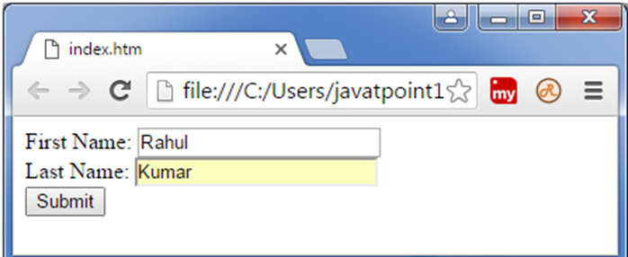
Open the page index.html and fill the entries:

Slide 15
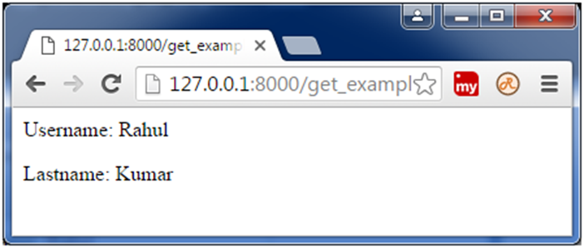
Output:

Slide 16
Example 4 :- Express.js GET Method:-Get method facilitates you to send only limited amount of data because data is sent in the header. It is not secure because data is visible in URL bar.
File:index.html
<!DOCTYPE html>
<html>
<body>
<form action="http://127.0.0.1:8000/get_example3">
<table>
<tr><td>Enter First Name:</td><td><input type="text" name="firstname"/><td></tr>
<tr><td>Enter Last Name:</td><td><input type="text" name="lastname"/><td></tr>
<tr><td>Enter Password:</td><td><input type="password" name="password"/></td></tr>
<tr><td>Sex:</td><td>
<input type="radio" name="sex" value="male"> Male
<input type="radio" name="sex" value="female">Female
</td></tr>
<tr><td>About You :</td><td>
<textarea rows="5" cols="40" name="aboutyou" placeholder="Write about yourself">
</textarea>
</td></tr>
<tr><td colspan="2"><input type="submit" value="register"/></td></tr>
</table>
</form>
</body>
</html>

Slide 17
File: get_example.js
var express = require('express');
var app=express();
app.get('/get_example3', function (req, res) {
res.send('<p>Firstname: ' + req.query['firstname']+'</p>
<p>Lastname: '+req.query['lastname']+'</p><p>Password: '+req.query['password']+'</p>
<p>AboutYou: '+req.query['aboutyou']+'</p>');
})
var server = app.listen(8000, function () {
var host = server.address().address
var port = server.address().port
console.log("Example app listening at http://%s:%s", host, port)
})

Slide 18
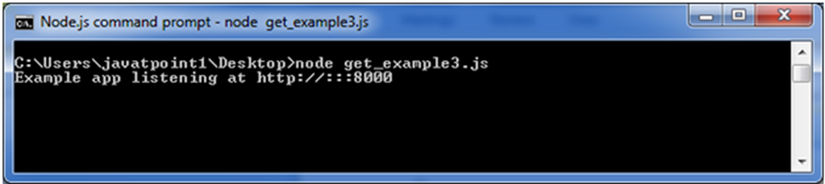
Command Prompt:

Slide 19
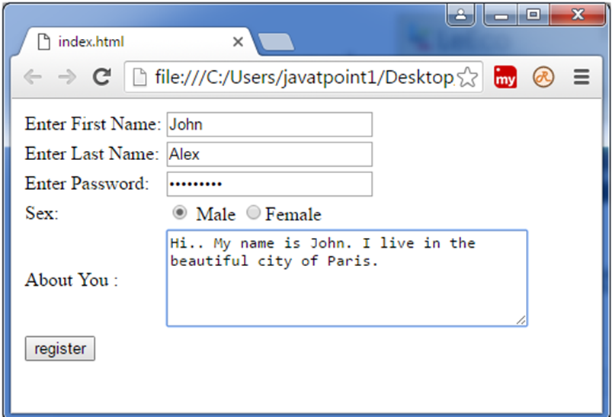
Output :-

Slide 20
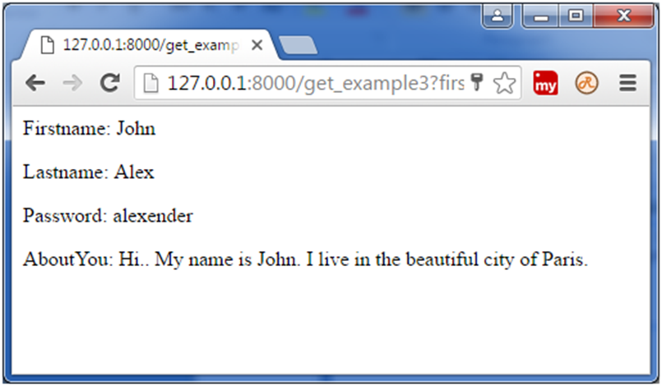
Output:-

Slide 21
Example 5 :- Express.js POST Request:-GET and POST both are two common HTTP requests used for building REST API's. POST requests are used to second large.
File: Index.html
<html>
<body>
<form action="http://127.0.0.1:8000/process_post" method="POST">
First Name: <input type="text" name="first_name"> <br>
Last Name: <input type="text" name="last_name">
<input type="submit" value="Submit">
</form>
</body>
</html>

Slide 22
File: post_example.js
var express = require('express');
var app = express();
var bodyParser = require('body-parser');
// Create application/x-www-form-urlencoded parser
var urlencodedParser = bodyParser.urlencoded({ extended: false })
app.use(express.static('public'));
app.get('/index.html', function (req, res) {
res.sendFile( __dirname + "/" + "index.html" );
})
app.post('/process_post', urlencodedParser, function (req, res) {
// Prepare output in JSON format
response = {
first_name:req.body.first_name,
last_name:req.body.last_name
};
console.log(response);
res.end(JSON.stringify(response));
})
var server = app.listen(8000, function () {
var host = server.address().address
var port = server.address().port
console.log("Example app listening at http://%s:%s", host, port)
})

Slide 23
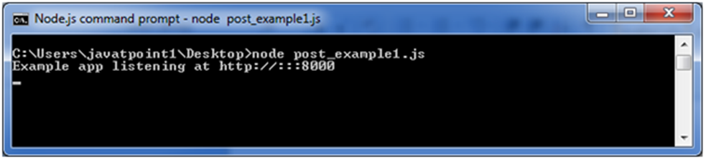
Command Prompt :-

Slide 24
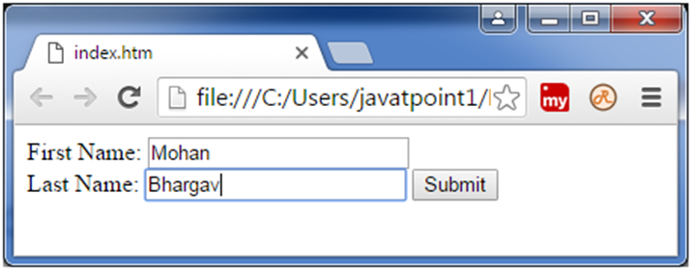
Open the page index.html and fill the entries:

Slide 25
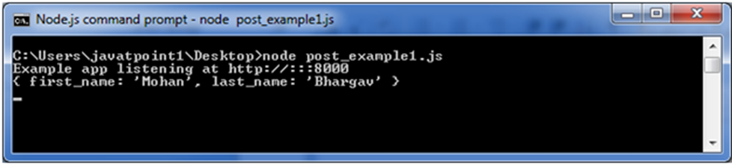
Now, you get the data in JSON format. Note: In the above picture, you

Slide 26
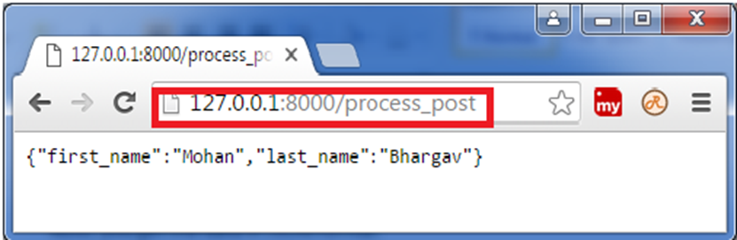
Note: In the above picture, you entries are not visible in the URL bar unlike GET method.

Slide 27
Example 6:-Express.js Request Object Properties:-There are Request Object properties seen one by one.
app.get('/example', (req, res) => {
// Accessing properties of the request object
const method = req.method; // HTTP method of the request (e.g., GET, POST)
const url = req.url; // URL of the request
const headers = req.headers; // HTTP headers of the request
const params = req.params; // URL parameters
const query = req.query; // Query parameters
const body = req.body; // Request body (parsed by body-parser middleware if used)
const cookies = req.cookies; // Cookies sent with the request
const ip = req.ip; // IP address of the client
// Do something with the request properties
// ...
res.send('Response sent!');
});

Slide 28
Example 7:-req.app:-This is used to hold a reference to the instance of the express application that is using the middleware.
const express = require('express');
const app = express();
app.get('/example', (req, res) => {
// Access the application object using req.app
const appInstance = req.app;
// Perform actions with the application object
appInstance.set('title', 'My Express App');
const appTitle = appInstance.get('title');
res.send(`Application title: ${appTitle}`);
});
app.listen(3000, () => {
console.log('Server is running on port 3000');
});

Slide 29
Example 8:-req.baseurl :It specifies the URL path on which a router instance was mounted.
const express = require('express');
const app = express();
const baseURL = '/api'; // Define your base URL here
// Define your routes
app.get(baseURL + '/users', (req, res) => {
// Handle GET /api/users
// ...
});
app.post(baseURL + '/users', (req, res) => {
// Handle POST /api/users
// ...
});
// ...
// Start the server
app.listen(3000, () => {
console.log('Server is running on port 3000');
});

Slide 30
Example 9: req.body :It contains key-value pairs of data submitted in the request body.
const express = require('express');
const app = express();
// Middleware to parse the request body
app.use(express.json());
// Route handler
app.post('/example', (req, res) => {
const requestBody = req.body;
// Do something with the data in req.body
// ...
res.send('Request body received');
});
app.listen(3000, () => {
console.log('Server started on port 3000');
});

Slide 31
Example 10:-req.cookies:When we use cookie-parser middleware, this property is an object that contains cookies sent by the request.
1.Install cookie-parser using npm or yarn:
npm install cookie-parser
2.Require and set up the cookconst express = require('express');
const express = require('express');
const cookieParser = require('cookie-parser');
const app = express();
app.use(cookieParser());
3. Access the cookies using req.cookies in your route handlers:
app.get('/example', (req, res) => {
const cookies = req.cookies;
// Access individual cookies by their names
const cookieValue = req.cookies.cookieName;
// ... do something with the cookies
res.send('Cookies received');
});

Slide 32
Example 11:-req.fresh:It specifies that the request is "fresh." it is the opposite of req.stale.
app.get('/data', function(req, res) {
// Check if the data is fresh
if (req.fresh) {
// The client already has the latest version of the resource
res.status(304).end(); // Not Modified
} else {
// The resource has been modified or it's the first request
// Send the updated resource
res.json({ data: 'updated data' });
}
});

Slide 33
Example 12:- req.hostname:It contains the hostname from the "host" http header.
const express = require('express');
const app = express();
app.get('/', (req, res) => {
const hostname = req.hostname;
res.send(`Hostname: ${hostname}`);
});
app.listen(3000, () => {
console.log('Server is running on port 3000');
});

Slide 34
Example 13:req.ip:It specifies the remote IP address of the request.
const express = require('express');
const app = express();
app.get('/', (req, res) => {
const clientIp = req.ip;
res.send(`Your IP address is: ${clientIp}`);
});
app.listen(3000, () => {
console.log('Server started on port 3000');
});

Slide 35
Example 14:req.path:It contains the path part of the request URL.
const express = require('express');
const app = express();
app.get('/users/:id', (req, res) => {
console.log(req.path); // Outputs the path portion of the URL
// ... rest of the route handler logic
});
app.listen(3000, () => {
console.log('Server started on port 3000');
});

Slide 36
Example 15:req.protocol:The request protocol string, "http" or "https" when requested with TLS.
const express = require('express');
const app = express();
app.get('/', (req, res) => {
const protocol = req.protocol;
res.send(`The current request protocol is ${protocol}`);
});
app.listen(3000, () => {
console.log('Server is running on port 3000');
});

Slide 37
Example 16:req.route:The currently-matched route, a string.
app.get('/users/:id', (req, res) => {
console.log(req.route.path); // "/users/:id"
console.log(req.route.methods.GET); // true
// Your code logic...
});

Slide 38
Example 17:req.secure:A Boolean that is true if a TLS connection is established.
app.use((req, res, next) => {
if (req.secure) {
// The request was made over HTTPS, continue processing
next();
} else {
// Redirect HTTP requests to HTTPS
res.redirect('https://' + req.headers.host + req.url);
}
});

Slide 39
Example 18: Hello World in Express.js:-Express is a node js web application framework that provides broad features for building web and mobile applications.
const express = require('express')
const app = express()
const port = 3000
app.get('/', (req, res) => {
res.send('Hello World!')
})
app.listen(port, () => {
console.log(`Example app listening on port ${port}`)
})

Slide 40
Run the app with the following command:
$ node app.js
Output:-
Hello World!

Slide 41
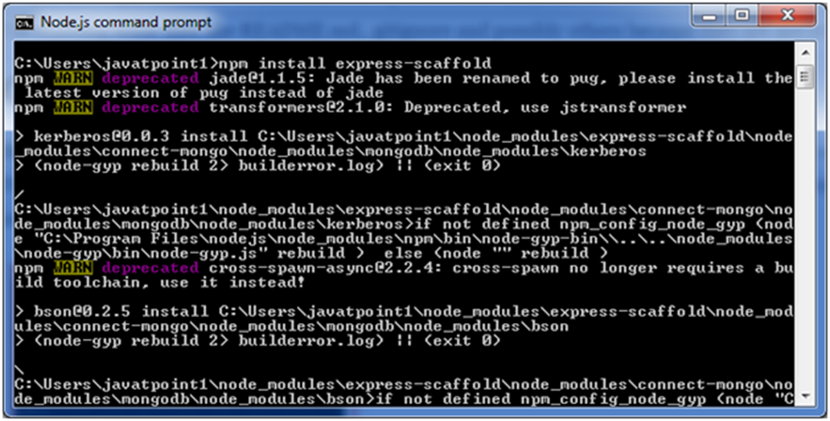
Example 19:- Express.js Scaffolding: Scaffolding is a technique that is supported by some MVC frameworks.
npm install express-scaffold

Slide 42
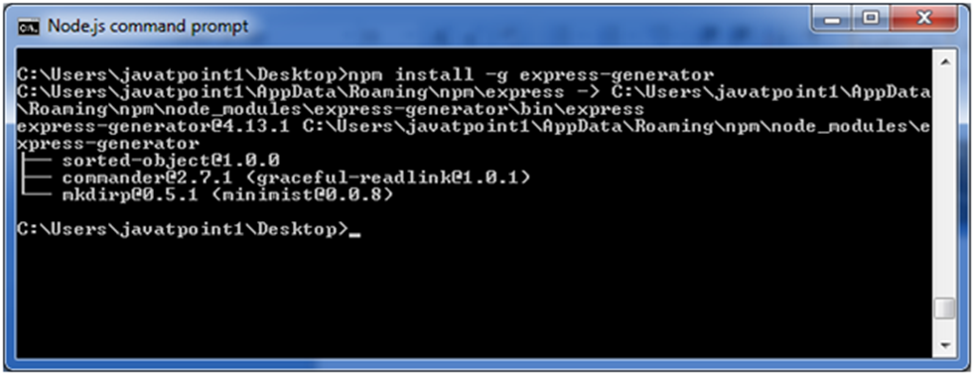
After this step, execute the following command to install express generator:
npm install -g express-generator

Slide 43
First create a directory named myapp. Create a file named app.js in the myapp directory having the following code:
var express = require('express');
var app = express();
app.get('/', function (req, res) {
res.send('Welcome to JavaTpoint!');
});
app.listen(8000, function () {
console.log('Example app listening on port 8000!');
});

Slide 44
Open Node.js command prompt, go to myapp and run npm init command (In my case, I have created myapp folder on desktop)

Slide 45
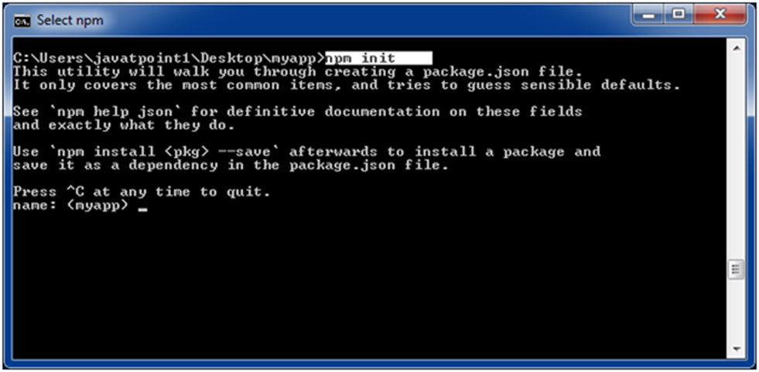
Fill the entries and press enter.

Slide 46
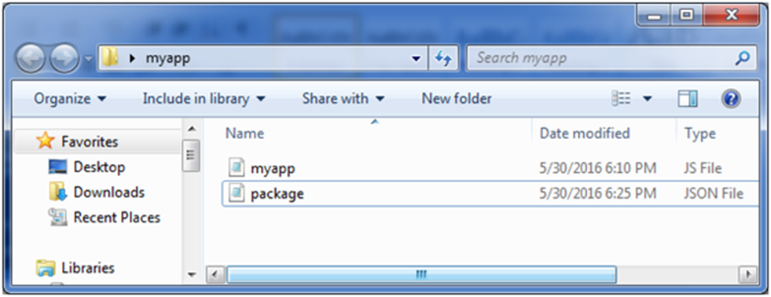
It will create a package.json file in myapp folder and the data is shown in JSON format.

Slide 47
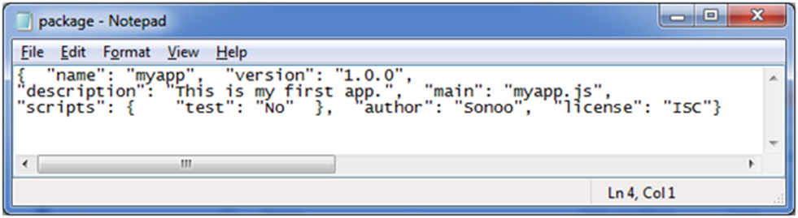
Output:

Slide 48
Example 20 :- Express.js Middleware:-Express.js Middleware are different types of functions that are invoked by the Express.js routing layer before the final request handler.
File: simple_express.js
var express = require('express');
var app = express();
app.get('/', function(req, res) {
res.send('Welcome to JavaTpoint!');
});
app.get('/help', function(req, res) {
res.send('How can I help You?');
});
var server = app.listen(8000, function () {
var host = server.address().address
var port = server.address().port
console.log("Example app listening at http://%s:%s", host, port)
})

Slide 49
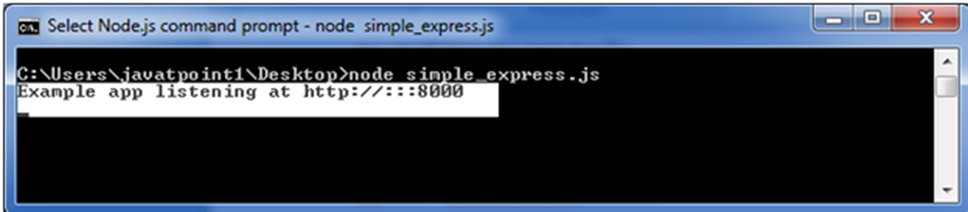
Command Prompt:
You see that server is listening.
Now, you can see the result generated by server on the local host http://127.0.0.1:8000

Slide 50
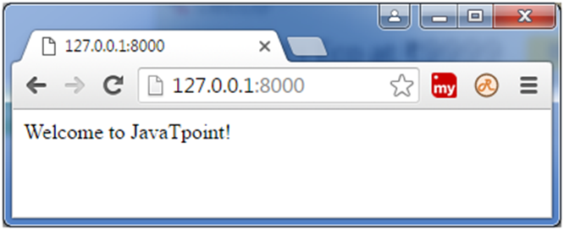
Output:

Slide 51
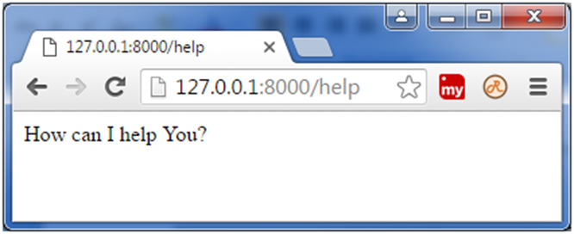
Output:-
Let's see the next page: http://127.0.0.1:8000/help

